Slide 1

ROB 311-Task 6 K-Means
Adriana TAPUS & Chuang YU
adriana.tapus@ensta-paris.fr & chuang.yu@ensta-paris.fr
10-2020

Slide 2
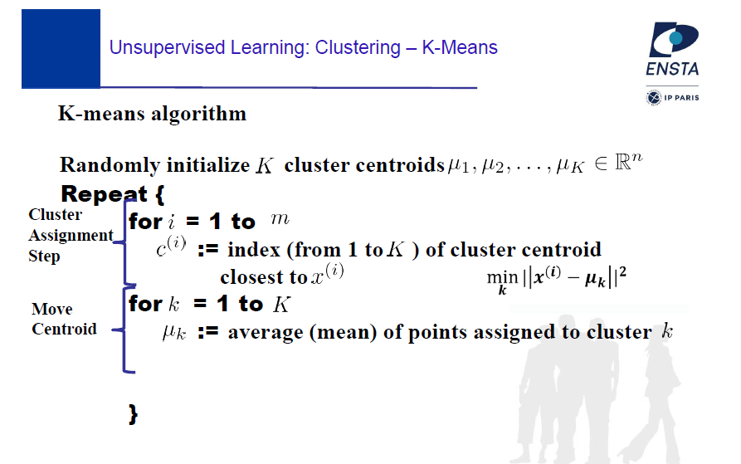
1. K-means
adriana.tapus@ensta-paris.fr
Notes:
OneNote explain it in short.

Slide 3

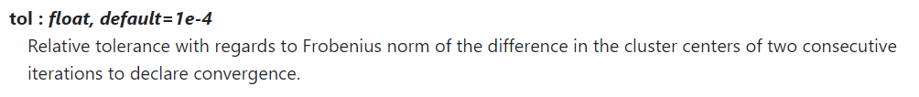
1. K-means
sklearn.cluster.Kmeans()
Parameters:
10
When to stop
https://scikit-learn.org/stable/modules/generated/sklearn.cluster.KMeans.html
Notes:
OneNote explain it in short.

Slide 4
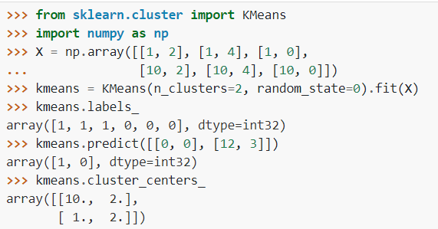
1. K-means
https://scikit-learn.org/stable/modules/generated/sklearn.cluster.KMeans.html
Notes:
OneNote explain it in short.

Slide 5
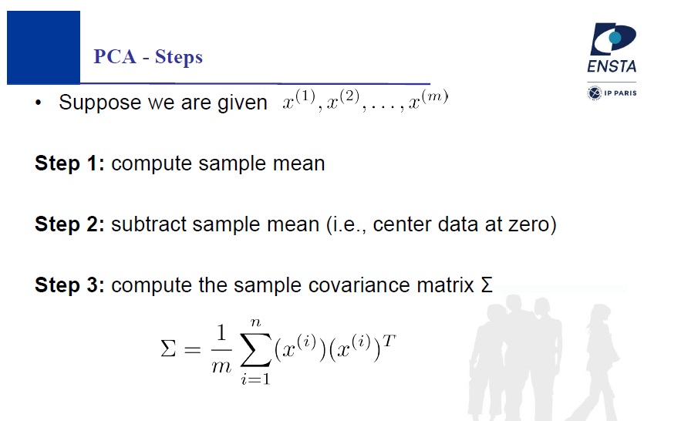
2. PCA-Dimensionality Reduction
adriana.tapus@ensta-paris.fr
Notes:
…….

Slide 6
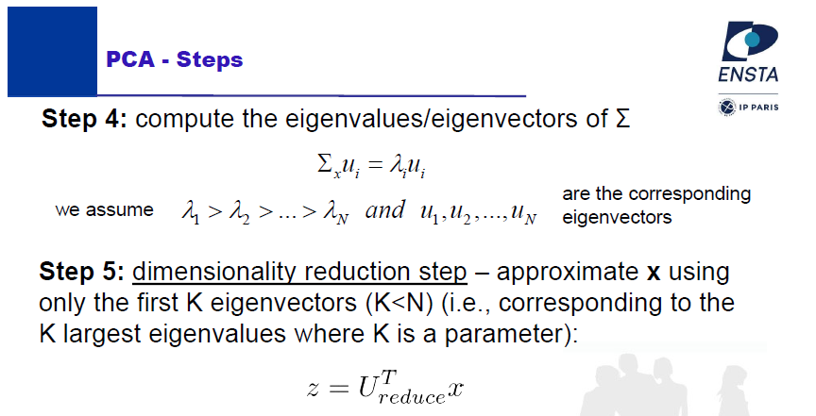
2. PCA-Dimensionality Reduction
adriana.tapus@ensta-paris.fr
Notes:
…….

Slide 7
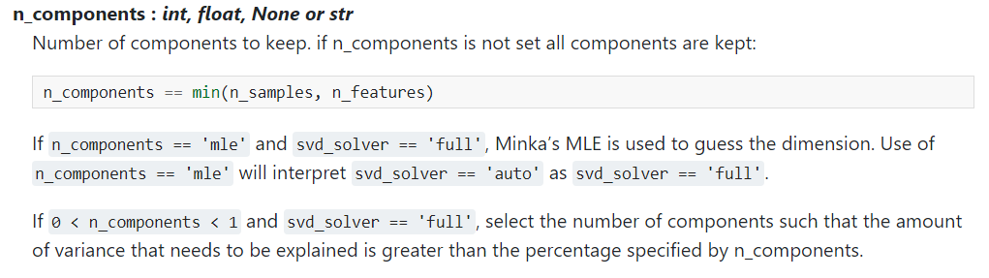

2. PCA-Dimensionality Reduction
sklearn.decomposition.PCA()
Parameter
https://scikit-learn.org/stable/modules/generated/sklearn.decomposition.PCA.html
Notes:
…….

Slide 8
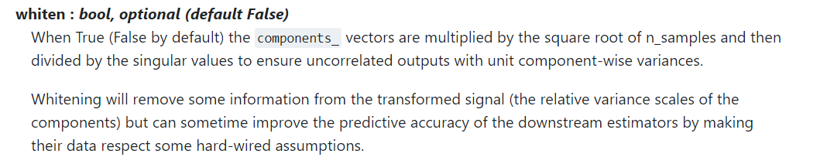

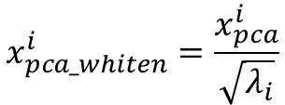

2. PCA-Dimensionality Reduction
sklearn.decomposition.PCA()
Parameter
1.PCA$:$
$$x_{pca}^{i}=U^{T}x^{i}$$
$$x_{pca_whiten}^{i}=\frac{x_{pca}^{i}}{\sqrt{λ_{i}}}$$
2. Whiten:
https://scikit-learn.org/stable/modules/generated/sklearn.decomposition.PCA.html
Notes:
…….

Slide 9
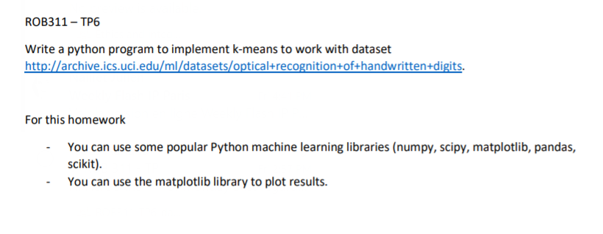
3. TASK 6
Notes:
…….

Slide 10

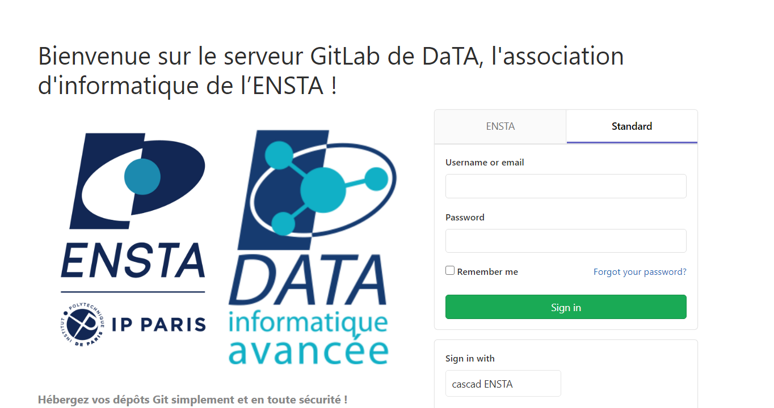
Rule --2 persons in one group --Dealine: Bedore Monday Submit: --Report paper + code --Github or ENSTA gitlab
or

Slide 11
End!
Question?

